Slide 1
Welcome and logistics
Tuesday 26 May 2020
Economy Board
Notes:
Marvin opens speaking

Slide 2
City update
Workshop 1
1) What does recovery mean to you and what is the role of the economy in this?
There is still lots of coping going on rather than recovery
Going back to a new normal and tackling inequalities that have been exposed
Ensuring businesses have a positive impact on sustainability and inclusivity
Need to support young and marginalised people into the job market - particularly through skills and training
2) What will be the biggest differences we will see in a post COVID-19 city and economy? (e.g. ways of working, the high street, transport needs etc.)
Transport changes with opportunity to fast forward modal shift in walking and cycling and associated health benefits
High streets will be significantly impacted as more people see the ease of shopping online
Large scale changes to retail practices and home working will be more agile
There will be an larger need to tackle inequality and provide opportunities for unemployed
Need to consider visitor economy and protect our city’s strengths
#BristolOneCity @BristolOneCity
Notes:
Ed

Slide 3
City update
Workshop 1
3) What are the levers needed for us to deliver the One City 2050 vision* post COVID-19 and what do we have within our control?
One City Plan and One City Approach are will help to ensure inclusivity and sustainability
Can we use the City Values to bring different organisations together
Our diverse and young population
Our carbon neutral ambitions can unlock new opportunities
Move from GDP to wellbeing and focusing on broader agendas like the SDGs
Utilise our current strengths around in education, inclusion and employment
Realism about what we can and can’t solve as a city and lobbying to national government to ensure any stimuli are provided appropriately

Slide 4
Workshop 1 Word Cloud
What one word describes how you feel after this workshop?

Slide 5
City update
Workshop 2
What are the top three challenges for your economic sector?* (now, in a social distancing model, upon lifting of lock-down – noting that timing will be critical for some)
Confidence in the city and the economy leading to issues in long term planning, returning to work, public transport usage, drops in sales and demand for business
Inequality and social inclusion – ability to work from home (low income workers), access to resources (e.g. laptops)
Cash flow, and supply chains, accessing innovation and investment capital
Challenges of working from home and reopening while maintaining social distancing
What are the top three enablers for your sector to recover? (noting city, regional and national levers and spans of control)
Strong leadership – already demonstrated through One City Approach
Digital flexibility around working habits, education
Closer working between employers and schools around returning to work and education
Banks and mortgage companies delaying repayments – changes in legislation required
#BristolOneCity @BristolOneCity
Notes:
Ed

Slide 6
City update
Workshop 2
What are the top three enablers for your sector to recover? (noting city, regional and national levers and spans of control)
Businesses working to ensure they provide social good, prioritising support for those that do and pushing organisations to use SDGs in build back approaches
Integration of approaches with health and social care working closer with VCSE
Cash and national subsidies to support digital, tech, transport, communication, media
What are the top three ways that it could move beyond where it was before?
Modern methods of construction
Holistically addressing issues through interconnected approaches
Use of the SDGs as a way of sharing and learning internationally
Ensuring we upskill and reskill appropriated – particularly using education as a social enabler
Opportunity to decentralise from London – focusing on inward investment
Ensuring we use tech and agile working to benefit everyone going forward
Developing the South West as a Low-carbon hub global (particularly aerospace)
Using virtual approaches to reopening and continuing Bristol’s cultural and creative excellence

Slide 7
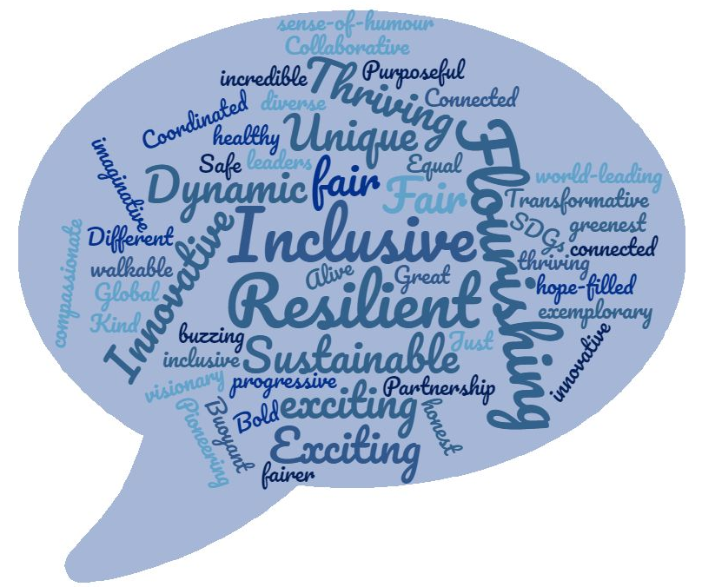
Workshop 2 Word Cloud
What one word would you like to describe Bristol in 10 years time

