Slide 1
Workforce race equality in the NHS
Dr Habib Naqvi
October 2019

Slide 2
The NHS Constitution
The NHS belongs to the people
It is there to improve our health and wellbeing, supporting us to keep mentally and physically well, to get better when we are ill and, when we cannot fully recover, to stay as well as we can to the end of our lives. It works at the limits of science – bringing the highest levels of human knowledge and skill to save lives and improve health. It touches our lives at times of basic human need, when care and compassion are what matter most.

Slide 3
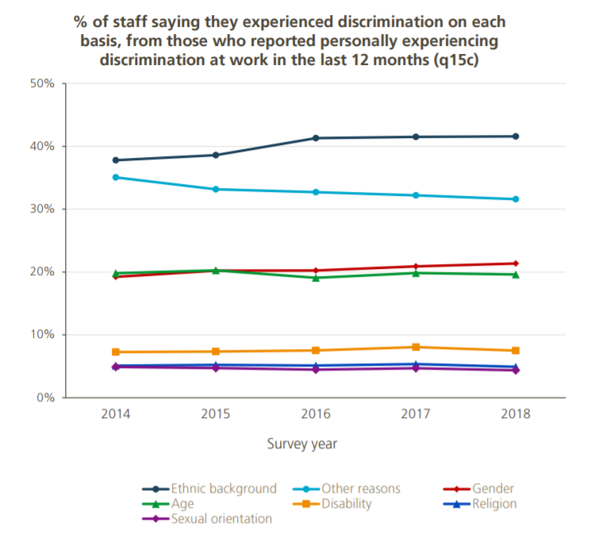
Discrimination by protected characteristic
In the 2019 survey 12.8% of staff reported experiencing discrimination at work (q15a & b).
Ethnic background continues to be the most common reason for discrimination.

Slide 4
Ethnicity of NHS staff in London trusts by AfC bands – 2018
Notes:
This taken is taken from the national ESR system.
AfC only (excludes local pay grades)

Slide 5
Black and Minority Ethnic (BME) staff in the NHS, 2018 – scale of the challenge
But…
8 BME CEOs (from ~231 Trusts)
10 Chairs
9 Executive Directors of Nursing
37 Medical Directors
Less than 6% very senior managers from BME backgrounds
7% BME board representation
This is a significant improvement from 2015!
1.4 million people work in the NHS
20% staff from BME backgrounds
28% GPs from BME backgrounds
40% of Hospital Doctors are from BME backgrounds
21% Nurses and Midwives (qualified and unqualified) rising to more than 50% in London

Slide 6
The reasons for tackling workforce inequality in the NHS
THE QUALITY CASE
Helps ensure high quality care, patient satisfaction and patient safety
Link between staff satisfaction and patient outcomes
*For every 1 s.d point of increased engagement there are 2.4% less deaths in acute hospitals
THE FINANCIAL CASE
Staff engagement and organisational efficiency
Implications for boards
*For every 1 s.d point of increased engagement there is a saving of £1.7m in terms of agency and absenteeism costs
THE MORAL AND LEGAL CASES

Slide 7
WRES indicators of workplace experience and opportunity
Indicator 1
Percentage of staff in each of the AfC Bands 1-9 or Medical and Dental subgroups and VSM compared with the percentage of staff in the overall workforce
Indicator 2
Relative likelihood of BME staff being appointed from shortlisting compared to that of white staff being appointed from shortlisting across all posts
Indicator 3
Relative likelihood of BME staff entering the formal disciplinary process, compared to that of white staff entering the formal disciplinary process
Indicator 4
Indicator 1
Relative likelihood of BME staff accessing non mandatory training and CPD as compared to white staff
Indicator 5
Percentage of staff experiencing harassment, bullying or abuse from patients, relatives or the public in last 12 months
Indicator 6
Percentage of staff experiencing harassment, bullying or abuse from staff in last 12 months
Indicator 7
Percentage believing that trust provides equal opportunities for career progression or promotion
Indicator 8
Indicator 9
In the last 12 months have you personally experienced discrimination at work?
Percentage difference between the organisations’ Board membership and its overall workforce

Slide 8
2016-18 WRES data comparison: all NHS trusts in England – early signs of improvements
Indicator type | WRES indicator | Metric description | 2016 score | 2017 score | 2018 score**
WORKFORCE | 2 | Relative likelihood of White staff being appointed from shortlisting compared to that of BME staff being appointed from shortlisting across all posts | 1.57 | 1.60 | 1.49
 | 3 | Relative likelihood of BME staff entering the formal disciplinary process, compared to that of White staff entering the formal disciplinary process. | 1.56 | 1.37 | 1.24
 | 4 | Relative likelihood of White staff accessing non mandatory training and CPD compared to BME staff | 1.10 | 1.22 | 0.87
STAFF SURVEY* | 5 | Percentage of BME staff experiencing harassment, bullying or abuse from patients, relatives or the public in last 12 months. | 28.8% | 28.7% | 28.7%
 | 6 | Percentage of BME staff experiencing harassment, bullying or abuse from staff in last 12 months. | 26.5% | 26.3% | 27.8%
 | 7 | Percentage of BME staff believing that trust provides equal opportunities for career progression or promotion. | 73.8% | 75.5% | 71.5%
 | 8 | Percentage of BME staff personally experienced discrimination at work from a manager / team leader / colleague in the last 12 months | 13.6% | 13.8% | 15.0%
BOARD | 9 | Percentage of BME Board membership | 7.1% | 7.0% | 7.4%
* NHS Staff Survey data (indicators 5-8) relate to the year of survey data publication
** Initial analyses of 2018 WRES data relating to workforce (indicators 1-4) and the board (indicator 9)

Slide 9
Strategies for improving
Reducing managerial bias through education (e.g. diversity training, unconscious bias training) and feedback (diversity evaluations):
does not increase diversity in representation or at senior levels.
Mentoring and networking:
has very modest effects.
Mandatory programs, or programs with explicit authority, accountability, support from the leadership, developing psychologically safe spaces and monitoring interventions:
most effective.

Slide 10
Operational interventions for recruitment
Directorate and staff group deep-dive on data and root cause analyses.
Review of WRES indicators data by directorates and staff groups.
Providing written explanations, justification and advice for non-appointment of internal candidates.
Diverse interview panels:
appropriately trained and qualified BME staff on interview panels.
Blind auditioning:
The interview panel does not see the application/CV’s of applicants. Shortlisting done by different people.
Setting improvement targets and monitoring on a regular basis (e.g. quarterly).

Slide 11
Operational interventions for formal disciplinary action
Four good practice models being trailed in London. Chose one(s) that work for your organisation.
Decision tree checklist
Post action audit
Pre-formal action check by a director level member of staff
Pre-formal action check by a trained lay member of staff

Slide 12
A fair experience for all
The need for accelerated improvement: Within 76.2% of NHS trusts in England, in 2018, the relative likelihood of BME staff entering the formal disciplinary process compared to white staff was outside the 0.80 – 1.25 non-adverse relative likelihood zone.
Variation in rates of disciplinary action: London region remain the most challenged. Acute and mental health trusts have seen year-on-year improvements in reducing BME entry into the formal disciplinary process. In general, community provider and ambulance trusts have not shown the scale of improvement .
Our ambition - closing the ethnicity gap in disciplinary action: reach equality in terms of the likelihood of staff entering the disciplinary process for both white and BME staff across at least 90% of all NHS organisations by 2022.

Slide 13
Operational interventions for non-mandatory training and CPD
Consider the following:
Look at discrepancies in funded training
Track denials for training
Consider local talent management training
Is training necessary, or should we be focusing on ‘on the job’ experience?
Look for good practice from other trusts and organisations

Slide 14
Cultural transformation
Leadership behaviours and actions are important
Communication on WRES must emphasize the link between diversity and excellence i.e. better experiences of BME staff equal to better quality of care for patients.
Organisations need to proactively create a climate supportive of diversity. All Senior staff must challenge incivility at all levels – don’t be a bystander or collude.
Creating a psychologically safe environment where employees feel confident in expressing their ideas without fear of negative consequences for career prospects.

Slide 15
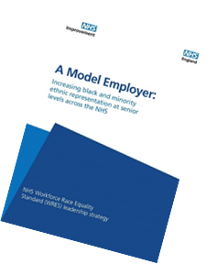
The NHS Long Term Plan, NHS People Plan and WRES
Respect, equality and diversity will be central to changing the culture and will be at the heart of the workforce implementation plan.
Through the WRES, we are making progress in addressing these issues from the perspective of BME staff.
Working with the WRES team, each NHS organisation will set its own target for BME representation across its leadership team and broader workforce.
This will help ensure senior teams and boards more closely represent the diversity of the workforce and local communities they serve.

Slide 16
Lessons learnt
Importance of demonstrable and compassionate leadership
Everyone’s agenda and not just to pass on to the EDI Lead
Middle managers (line managers and supervisors) are key and tend to be missed out in discussions and planning – a focus for interventions
Tokenism and copying-pasting of ‘good practice’ without adequate planning
consultancy firms, unconscious bias training
not tracking progress – waiting just to report WRES data at the end of the year
Hardwiring and embedding the agenda into corporate objectives and activities
Peer relationships between trusts – making better use of healthcare footprint (STPs/ICSs) to share good practice and learning

Slide 17
Resources and further information
Twitter (#WRES):
@DrHNaqvi
Website:
www.england.nhs.uk/wres/
Email:
england.wres@nhs.net

